Slide 1

INDIGENOUS
GOAT BREED DEVELOPMENT PVT. LTD.
Cin: u01100pn2022ptc209861
GSTin: 27AAGCI5953D1ZI

Slide 2
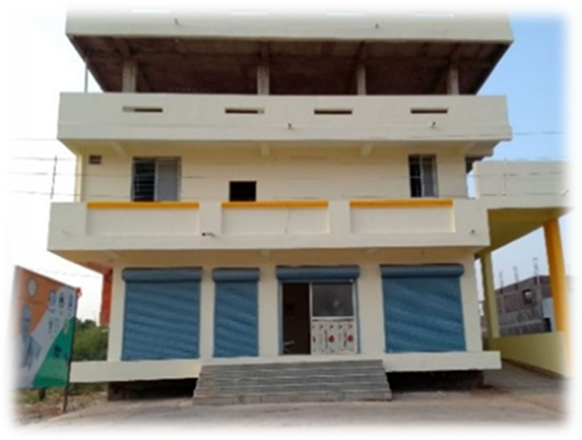
Zalawadi Goat milk enhancement project
This is a Socio-Economic Project so designed that it is bound to be feasible and viable economically on ground to benefit the marginal land holders, bpl & nomadic To prevent their migrations, and provide them a better standard of life.
This project is located in village Malpur in Sindkheda tehsil including more than 15 villages FROM the surrounding area of a radius of 30 kilometers From Malpur, covering the two neighboring districts dhule and Nandurbar.
We are programmed to yield 6,000 liter of goat milk per day in the first year increasing upto 15,000 liters of goat milk per day in next two years.
Our goal is to achieve a target to yield 25,000 liters of goat milk per day in consequent five years IN FUTURE

Slide 3
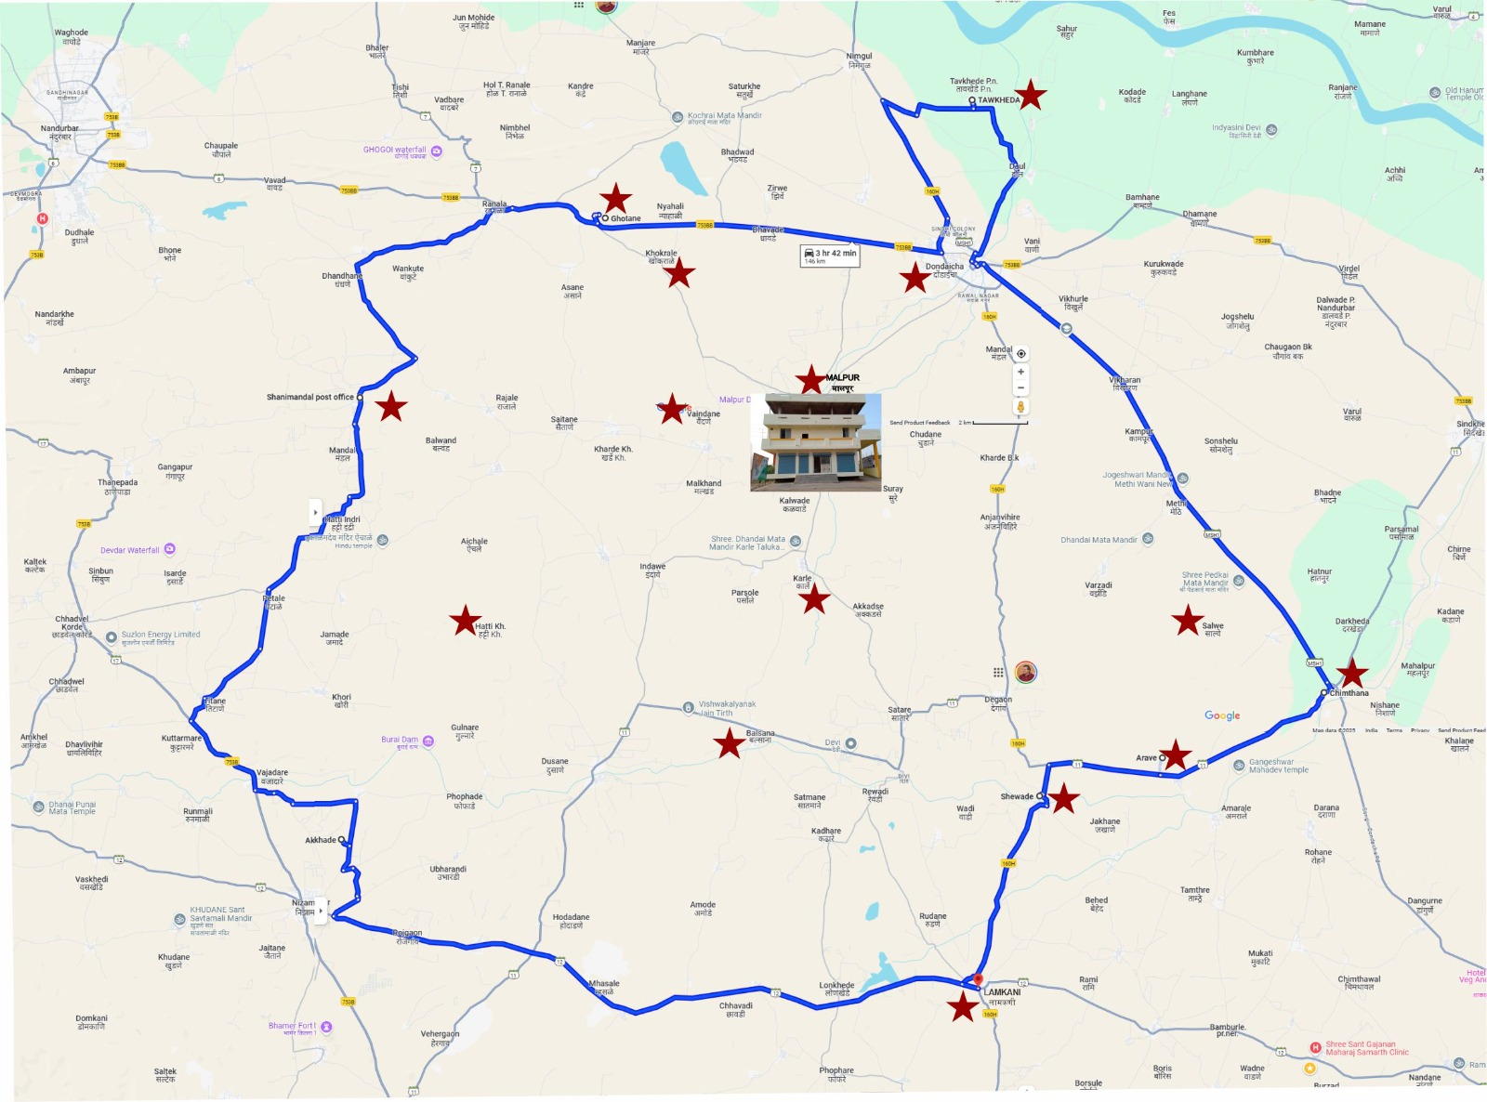
Following are the villages districtwise which are a part of our project.
Dhule
Nandurbar
Malpur
Dondaicha
Karle
Hatti
Balsane
Kharde
Anjanvihire
Shewade
Salve
Arave
Chimthane
Lamkani
Tavkheda.
Khokrale
Vaindane
Ghotane
Shanimandal
There are few more villages
Under process to be a part of the project

Slide 4
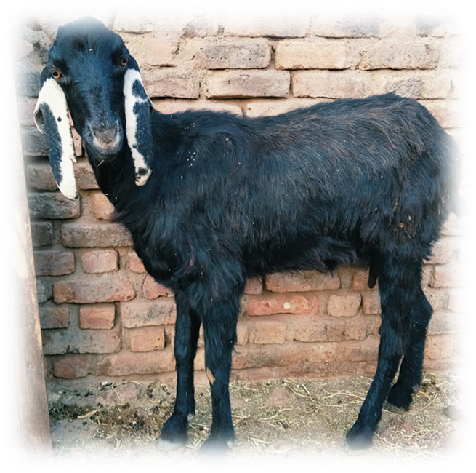
OBJECTIVES OF THE PROJECT.
OUR MAIN OBJECT IS COLLECTION OF GOAT MILK UNDER THREE ASPECTS.
QUALITY
QUANTITY
CONSISTENCY
TO FULFILL THISE OBJECTIVES
WE NEED TO IMPROVE THE GOAT REARING MANAGEMENT PRACTISES IN THE GOAT REARERS AND PROVIDE PROPER SERVICES TO THE CONSUMERS ON DAILY BASIS
ON THE OTHER HAND, WE NEED TO GET THE CONSUMER INTO THE HABIT OF CONSUMING GOAT MILK REGULARLY.

Slide 5
methodology
LOCAL MILK COLLECTORS
WE HAVE CONVINCED THE LOCAL MILK COLLECTORS TO COLLECT THE MILK ON BEHALF OF THE COMPANY
REGULARLY WITH PROPER SCIENTIFIC & HYGENIC MILK COLLECTION SYSTEM.
TAGGING AND COLLECTION OF DATA:
WITH THE HELP OF THE ANIMAL HUSBANDRY DEPARTMENT OF MAHARASHTRA GOVERNMENT WE HAVE TAGGED ALL ZALAWADI GOATS FROM OUR AREA OF OPERATION. AND WE ARE COLLECTING AND COMPILING
DETAILED MILKING DATA OF EACH GOAT WITH THE HELP OF THE DIGITAL TAGGING
WE ARE OBTAINING A COMPLETE DATA OF HEALTH, MEDICATION, LACTATION, FODDER, AND EVEN HABITS
OF EACH AND EVERY TAGGED GOAT IN OUR AREA OF OPERATION.
THIS DATA IS COLLECTED ON DAILY BASIS AND SENT TO OUR OFFICE FOR RECORD KEEPING
TO KEEP CHECK ON THE PERFORMANCE OF EACH GOAT.
USE OF MILKING DATA
THE ABOVE MILKING DATA IS OUR SOURCE OF INFORMATION OF THE GOATS
ENABLING US KEEP A QUALITY CONTROL AND ENHANCING THE QUALITY OF THE GOAT MILK.
.

Slide 6
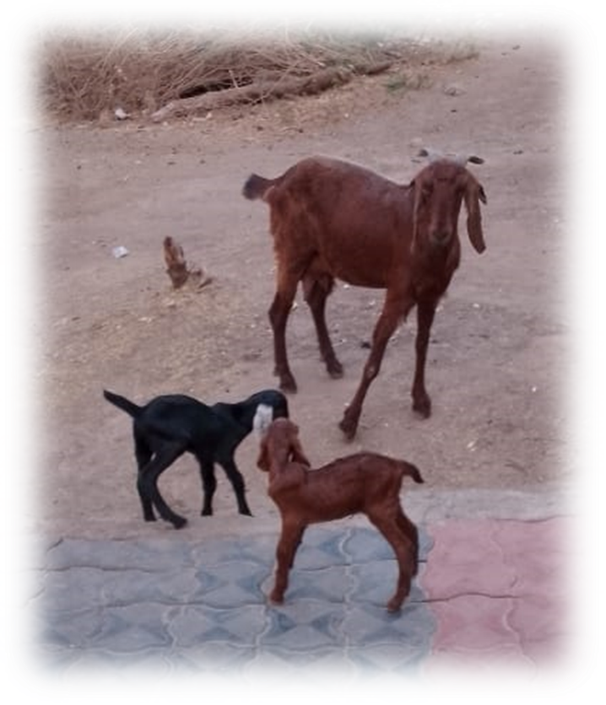
methodology
TRAINING TO FARMERS
WE WILL BE PROVIDING THE FARMERS A FORMAL COMPLETE TRAINING
OF THE MODERN METHODS OF GOAT REARING,
LIKE HOW TO IMPROVISE THE QUALITY OF
HEALTH, HYGIENE, MILKING DATA AND FODDER OF THEIR GOATS.
TRAINING TO STAFF
WE ARE TRAINING OUR STAFF HOW TO COLLECT, COMPILE AND SCRUTINIZE
THE MILKING DATA, HOW TO HANDLE THE GOATS AND GOAT REARERS
AND HOW TO IMPROVISE THE PRODUCTIVITY OF THE GOATS
LABORATORY
ONE MORE IMPORTANT ASPECT OF THIS PROJECT IS
A WELL-DESIGNED AND WELL-DEFINED LABORATORY.
THIS LAB WILL CHECK THE PH LEVEL OF MILK COLLECTED
AND PRESERVE THE RECORD OF EACH AND EVERY LITER OF COLLECTED MILK.
THIS LAB WILL BE WELL EQUIPPED WITH
ALL THE NECESSARY SURGICAL INSTRUMENTS AND APPARATUS

Slide 7
TARGETTED ACHIEVEMENT FOR MILK COLLECTION AFTER MONITORING AND MAINTAINING GOATS
AFTER OBSERVING AND PLANNING IN A PROPER WAY WE AIM AT COLLECTION AND PRESERVATION OF A GOOD QUALITY GOAT MILK
6,000 LITERS TO 10,000 LITERS DURING FIRST YEAR
10,000 LITERS TO 15,000 LITERS DURING SECOND YEAR
25,000 LITERS OF MILK DURING THIRD YEAR
BY ENHANCING THE QUALITY QUANTITY AND CONSISTENCY OF MILK THROUGHOUT THE YEAR.
THE BEST QUALITY OF MILK WILL PROVE TO BE COMPETENT IN THE OPEN MARKET
AND BRING STABILITY FOR THE REARERS IN FUTURE.

Slide 8
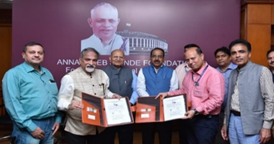
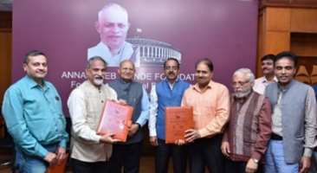
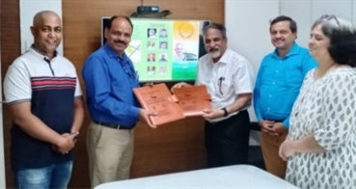
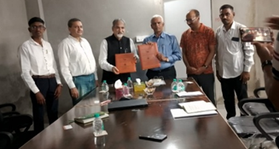
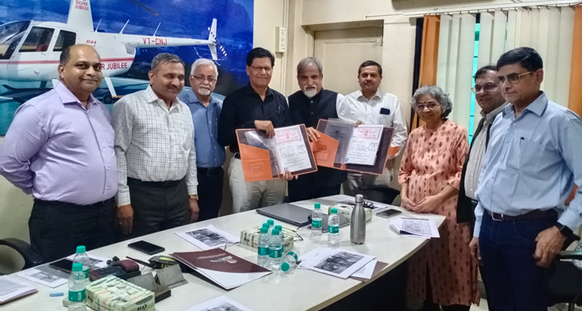
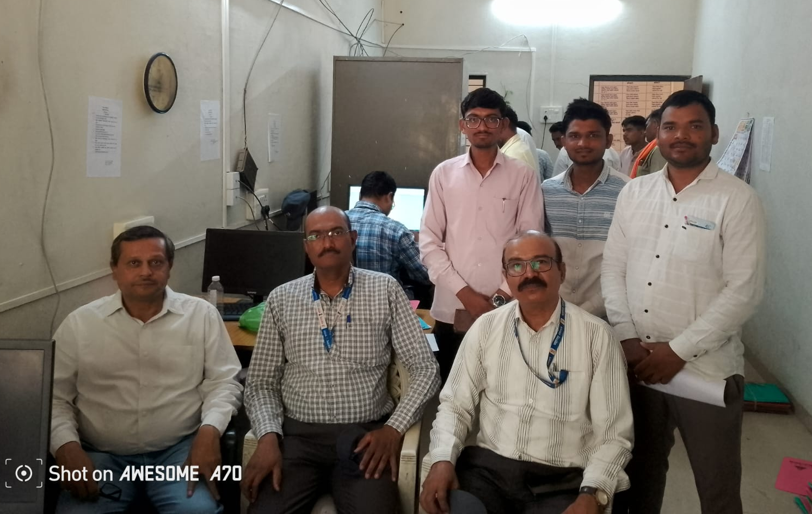
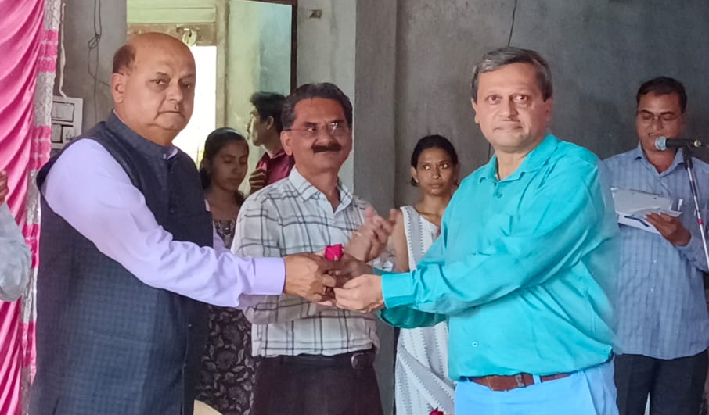
THE LEGENDS INVOLVED IN THE PROJECT
WITH ICAR-CIRG, MATHURA
WITH ICAR-CIRC, MEERUT
WITH ICAR-CSWRI, JAIPUR
WITH MAFSU, NAGPUR
WITH BAIF, PUNE
WITH ANIMAL
HUSBANDRY
DEPARTMENT,
MAHARASHTRA
WITH
BHARATIYA
KRUSHAK
SAMAJ

Slide 9
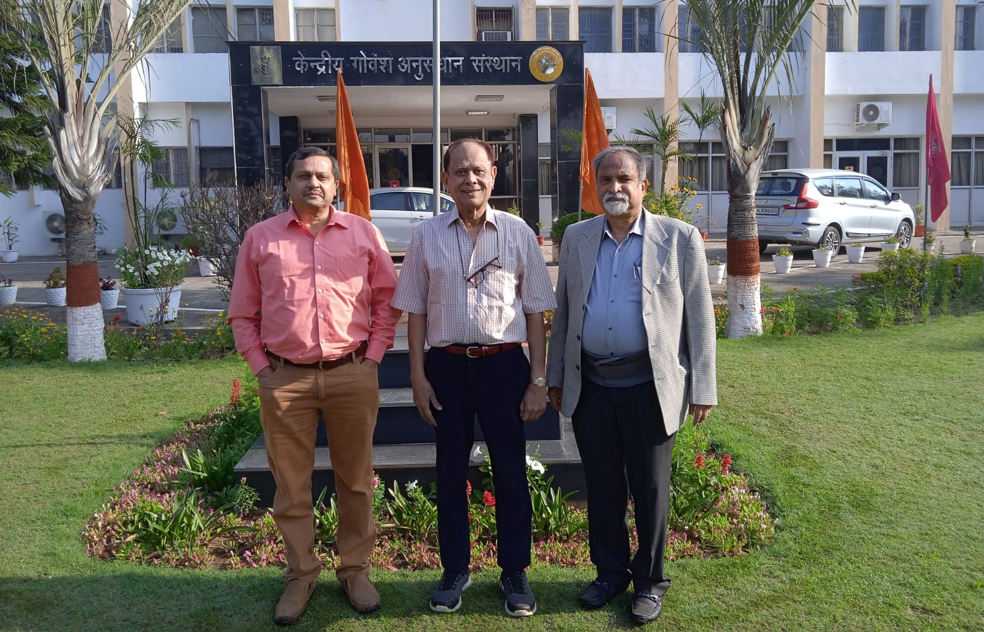
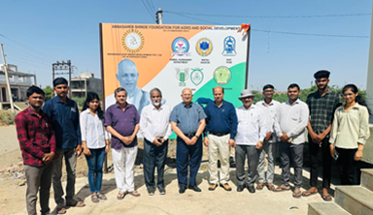
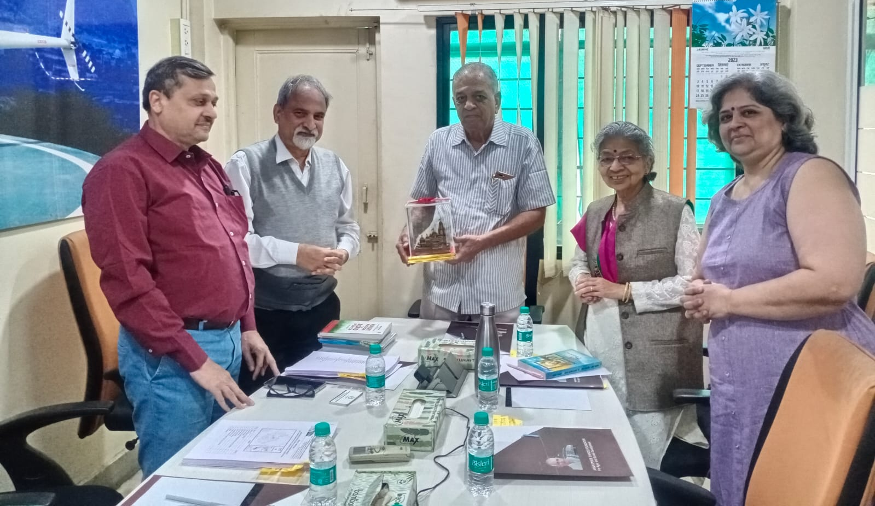
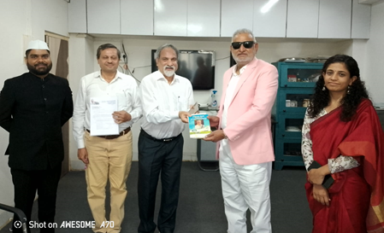
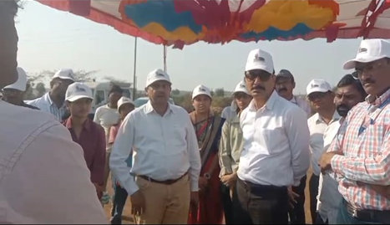
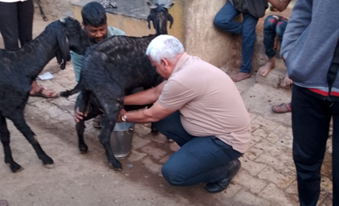
THE LEGENDS INVOLVED IN THE PROJECT
MR. ANIL ANNASAHEB SHINDE.
AND DR. SYED ALI
PADMA SHREE DR. RAJ PARODA AND DR. MANISHKUMAR CHATLI
DR. DATTATREY RANGANEKAR
& DR. ASHWINI GHORPADE
HON’BLE MINISTER AGRI.
SHRI. MAHADEV KOKATE, WITH HON’BLE COLLECTOR, NANDURBAR.
HON’BLE COLLECTOR,
DHULE DISTRICT
HON’BLE DR. NITEEN PATIL
VICE CHANCELLOR, MAFSU

Slide 10
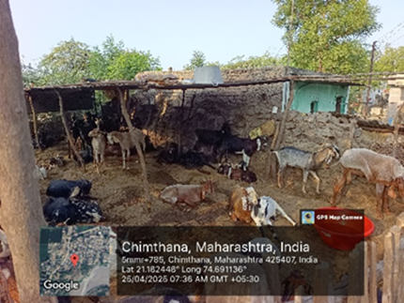
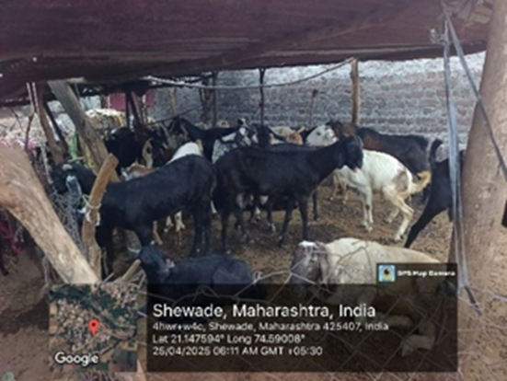
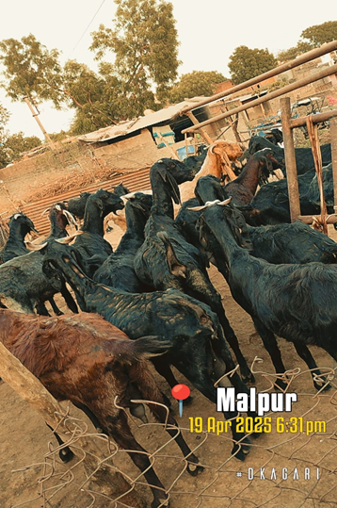
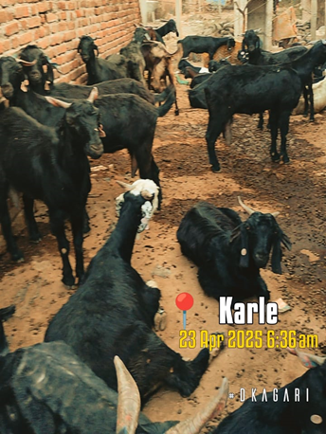
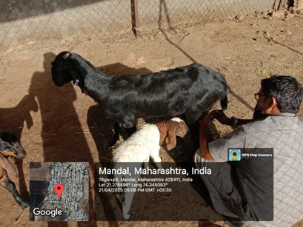
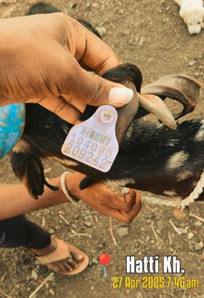
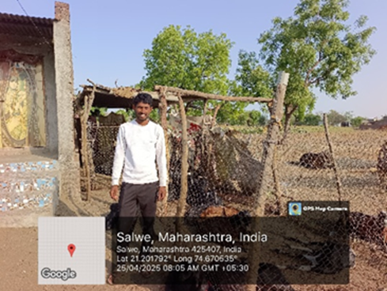
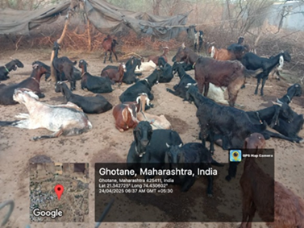
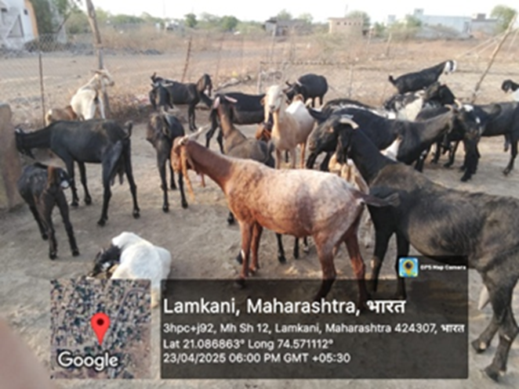
THE PROJECT
AT A GLANCE
CLICKED BY THE LSS STAFF
SHEWADE
CHIMTHANE
SHANIMANDAL
MALPUR
KARLE
HATTI KHURD
LAMKANI
SALWE
GHOTANE

Slide 11
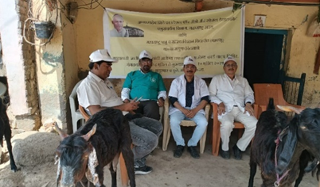
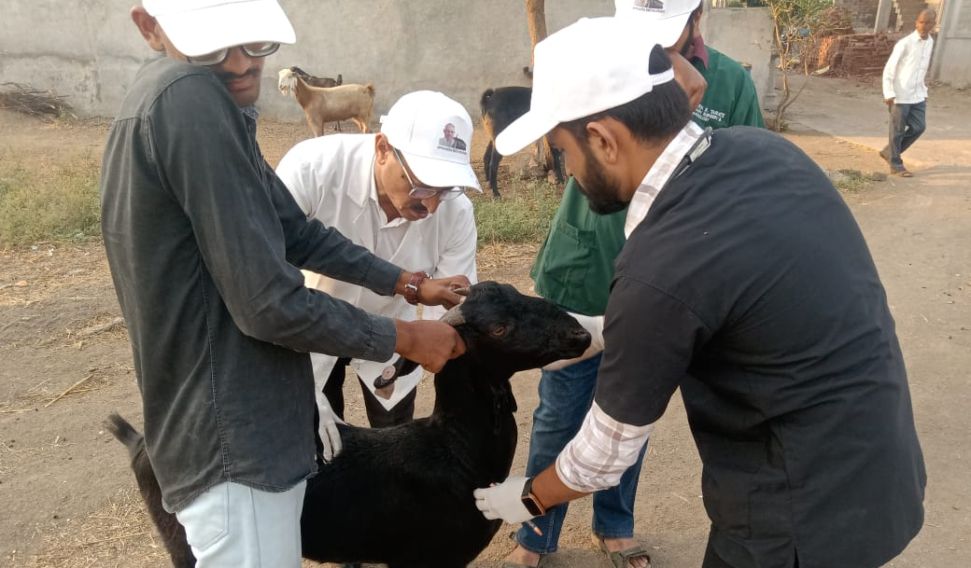
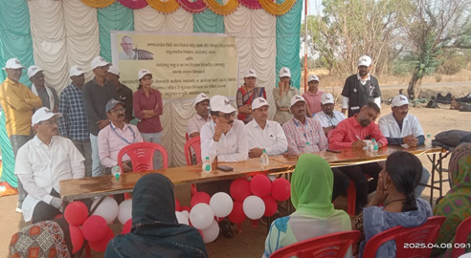
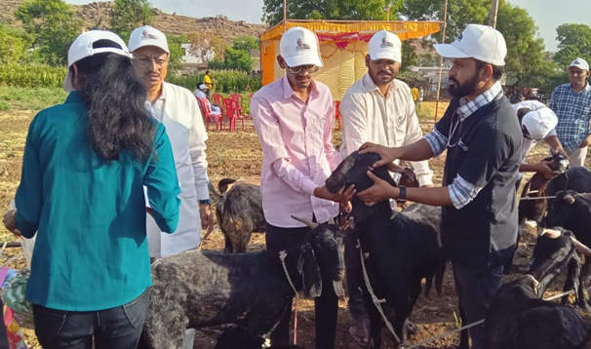
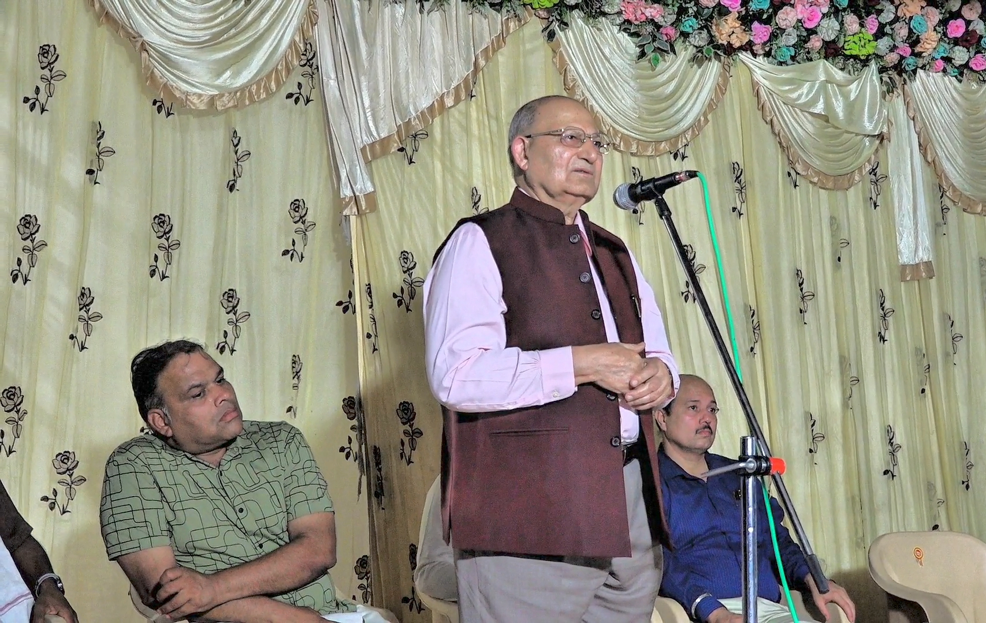
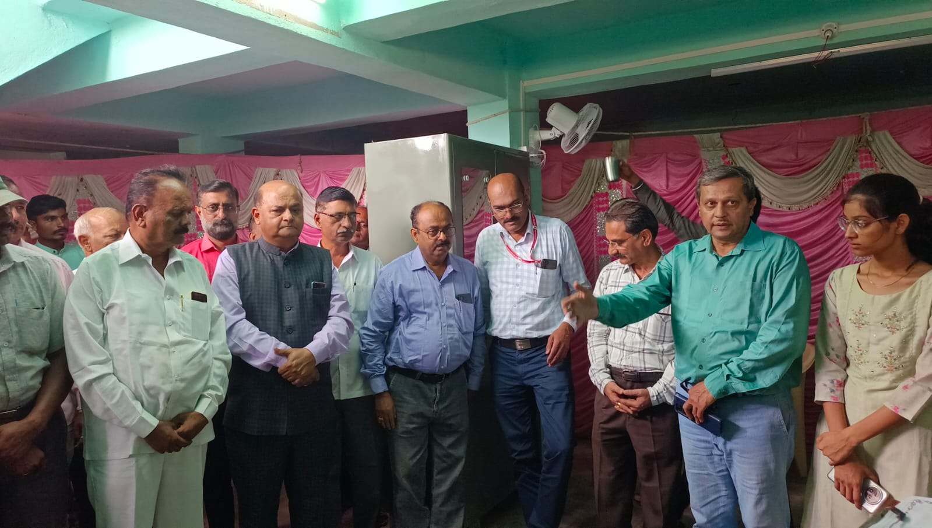
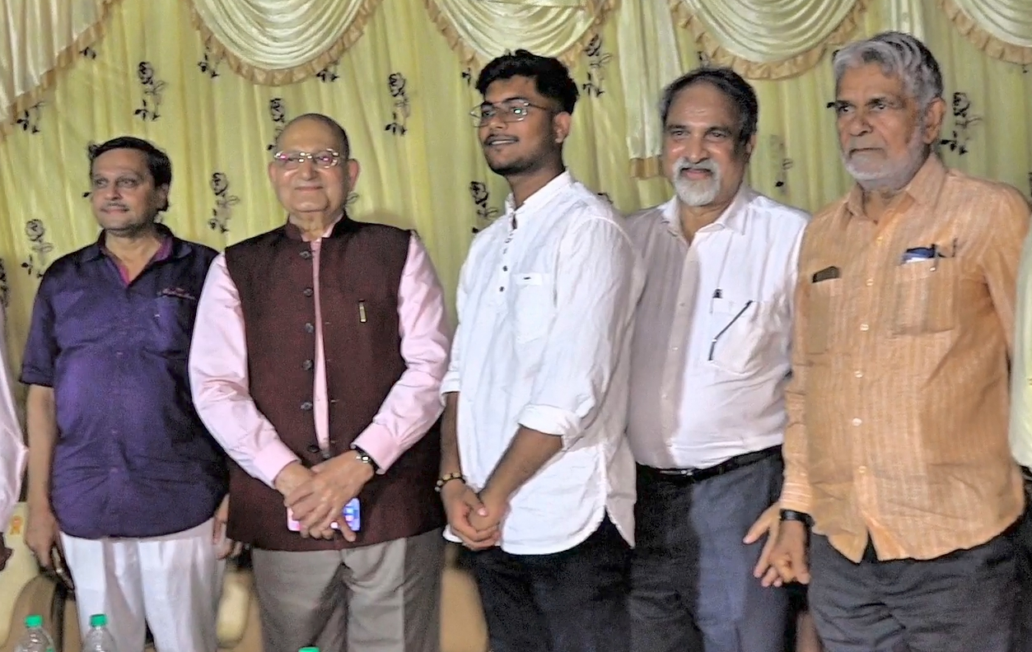
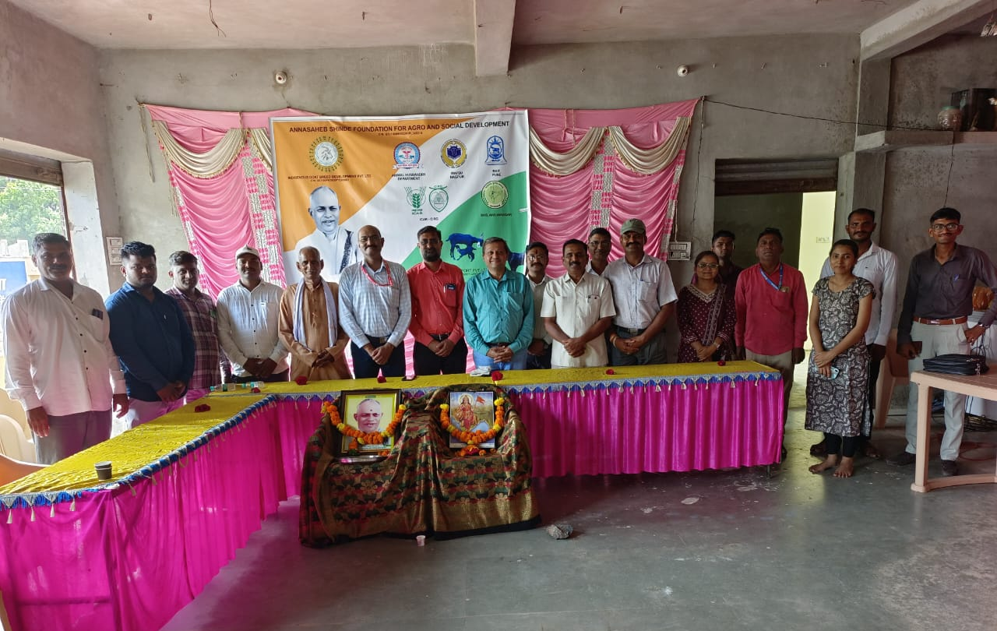
THE ZALAWADI GOAT HEALTH CHECKUP AND HEALTH CARD DISTRIBUTION CAMP,
10TH APRIL 2025
THE PUBLIC ANNOUNCEMENT OF THE PROJECT 29TH APRIL 2025
THE GOAT URINE DISTILLATION UNIT STARTS 15TH JULY 2025

Slide 12
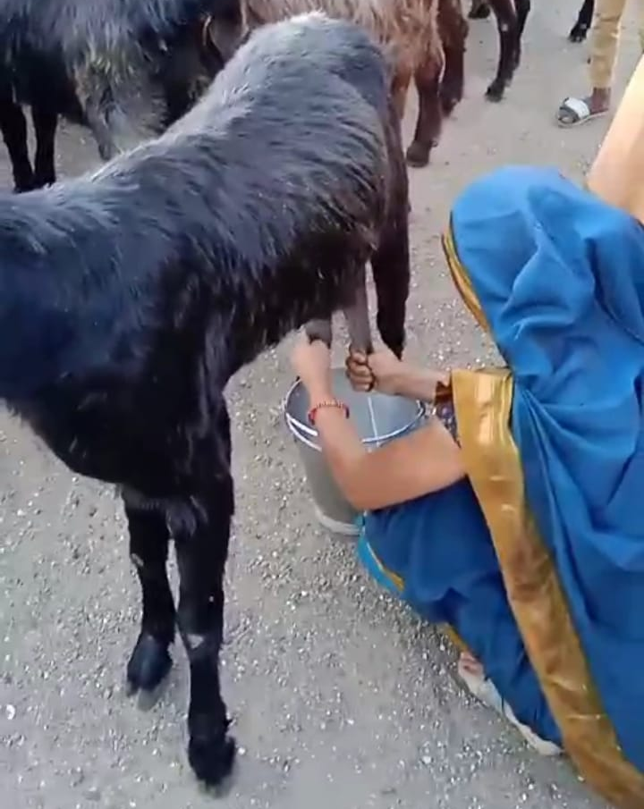
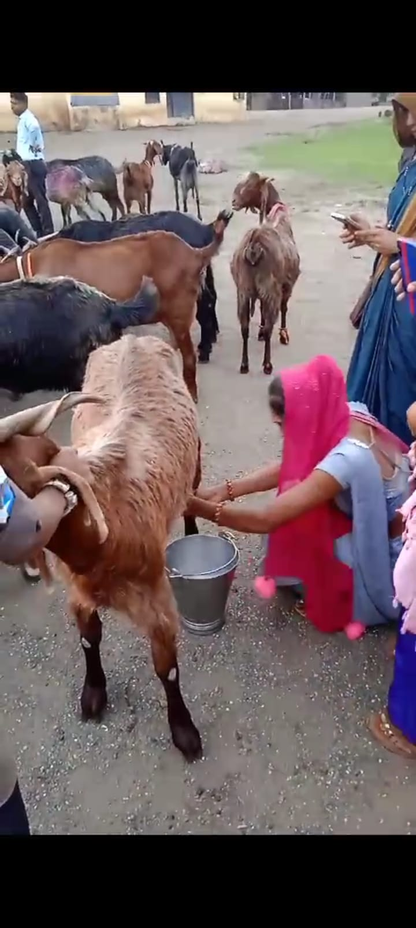
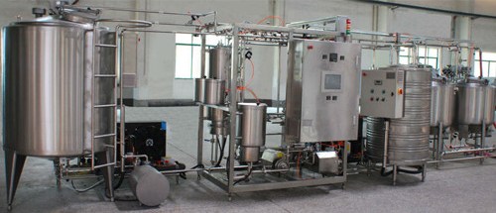
Value additional units
Since we all know the goat milk is a great immunity booster
having higher nutritional and medicinal values with lesser fat proportion.
We have focused on an improved marketing strategy for the same.
We aim at enabling the Goat Rearer get a competitive price for the milk.
Keep his goats free from all the diseases and epidemics.
Bring down the mortality rate down so that the Goat Rearers should
Be able to look at it throughout the year instead of selling it off.
We are also focused on enhancing the quality and quantity of the breed
as we are proud to preserve this indigenous heritage.

Slide 13
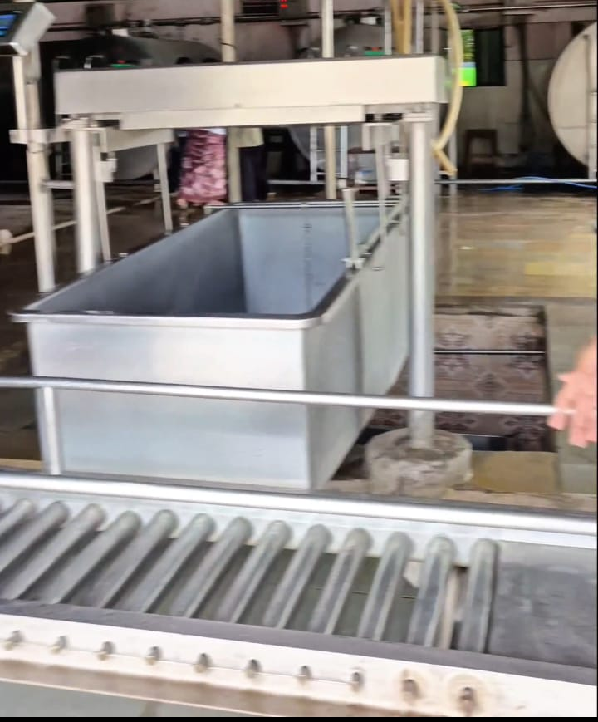
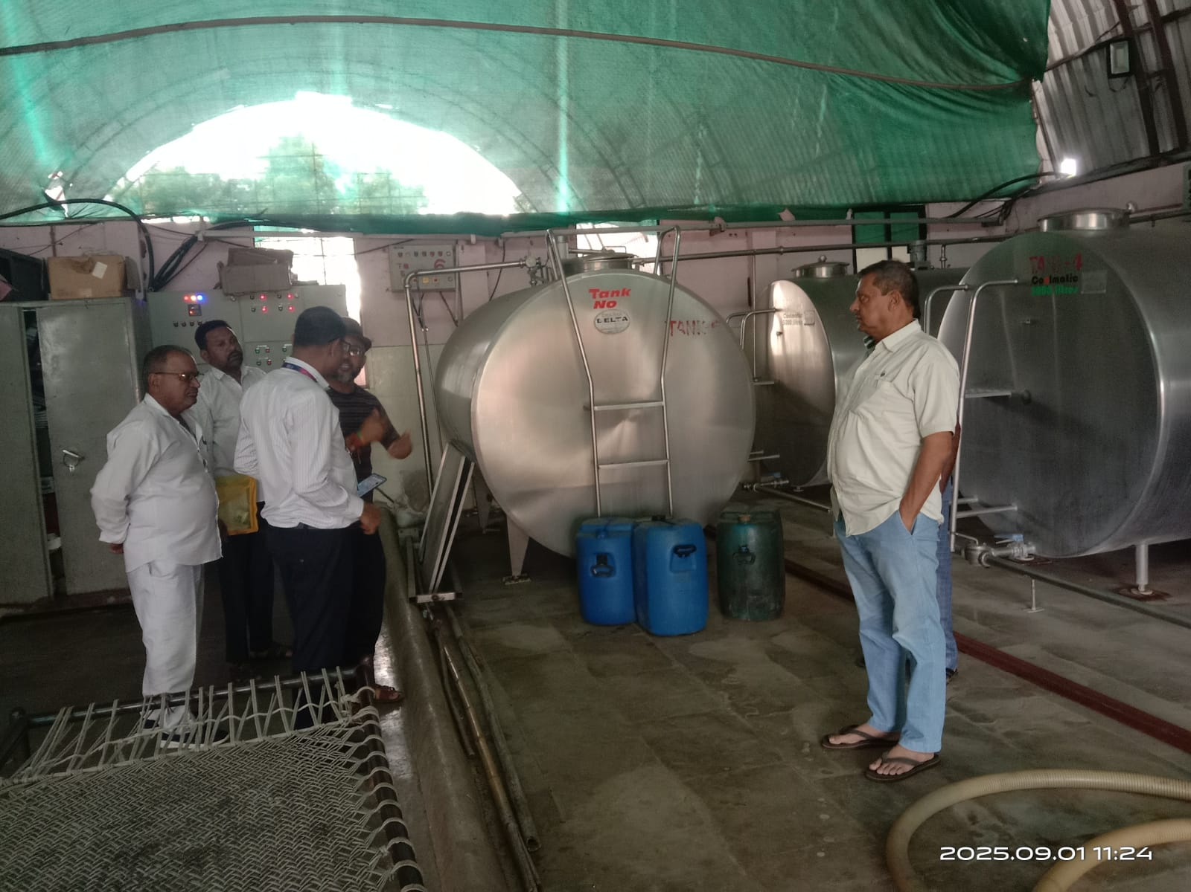
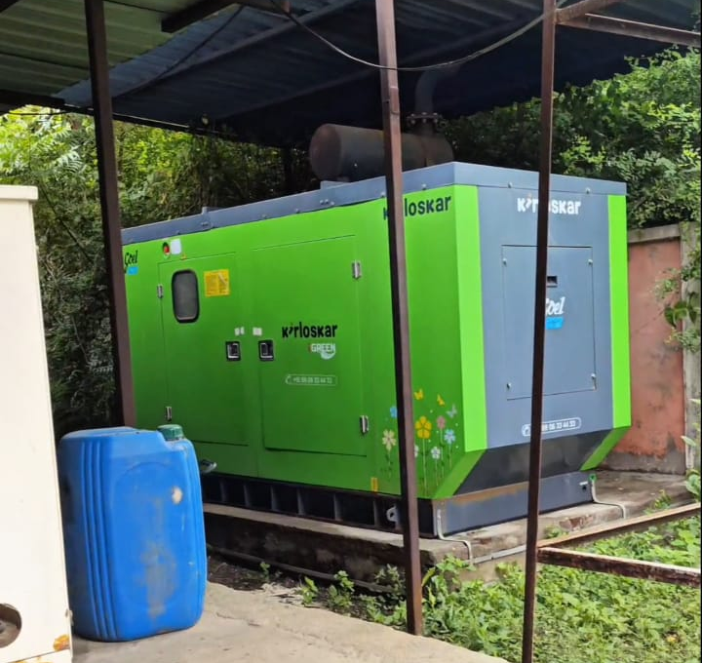
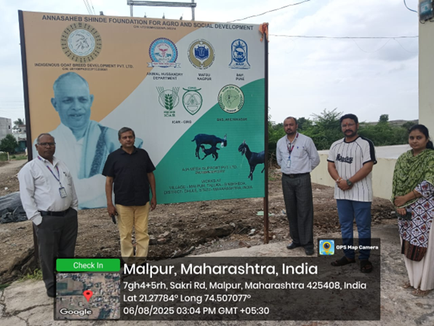
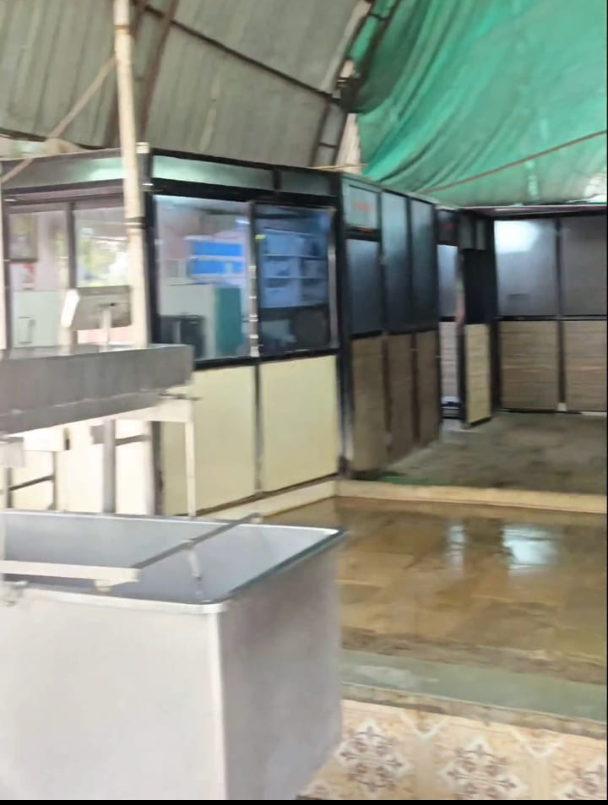
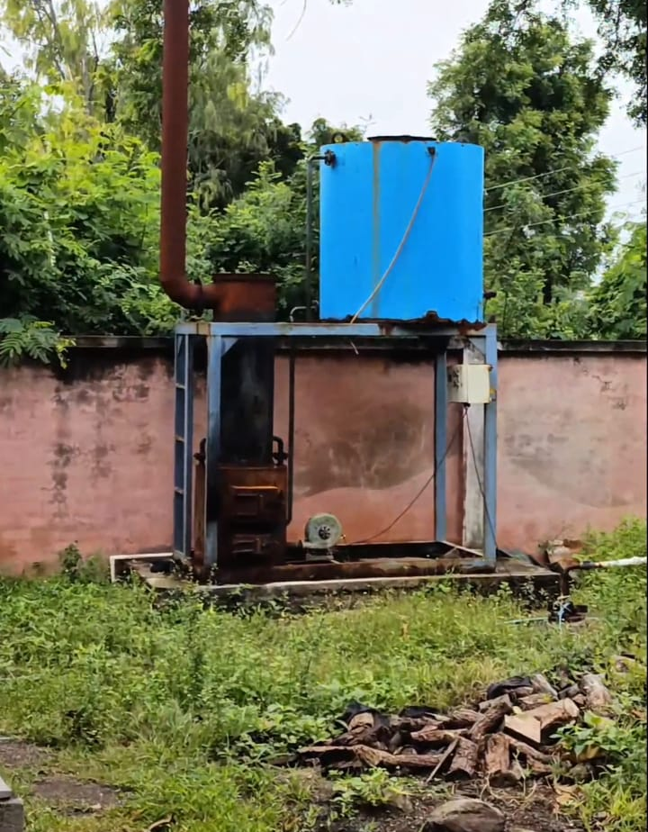
DAIRY AND MILK PROCESSING CENTER
WE HAVE NOW A COMPLETE READY DAIRY SET UP WITH A PROPER CONVEYOR BELT, COMPUTARISED WEIGHING MACHINE DUMP TANK, 6 BULK MILK CHILLER (BMC) CONTAINERS OF 5000 LTR EACH,
A PROPER LABORATORY SET UP
FOR ALL TYPES OF MILK TESTING.
ALONG WITH HOT WATER BOILER,
125 KILO VOLT-AMPERES GENERATOR,
A COMPLETE AIRCONDITIONING UNIT.
THE OFFICERS VISIT OF THE STATE BANK OF INDIA
TO OUR PROJECT OFFICE
AT MALPUR

Slide 14
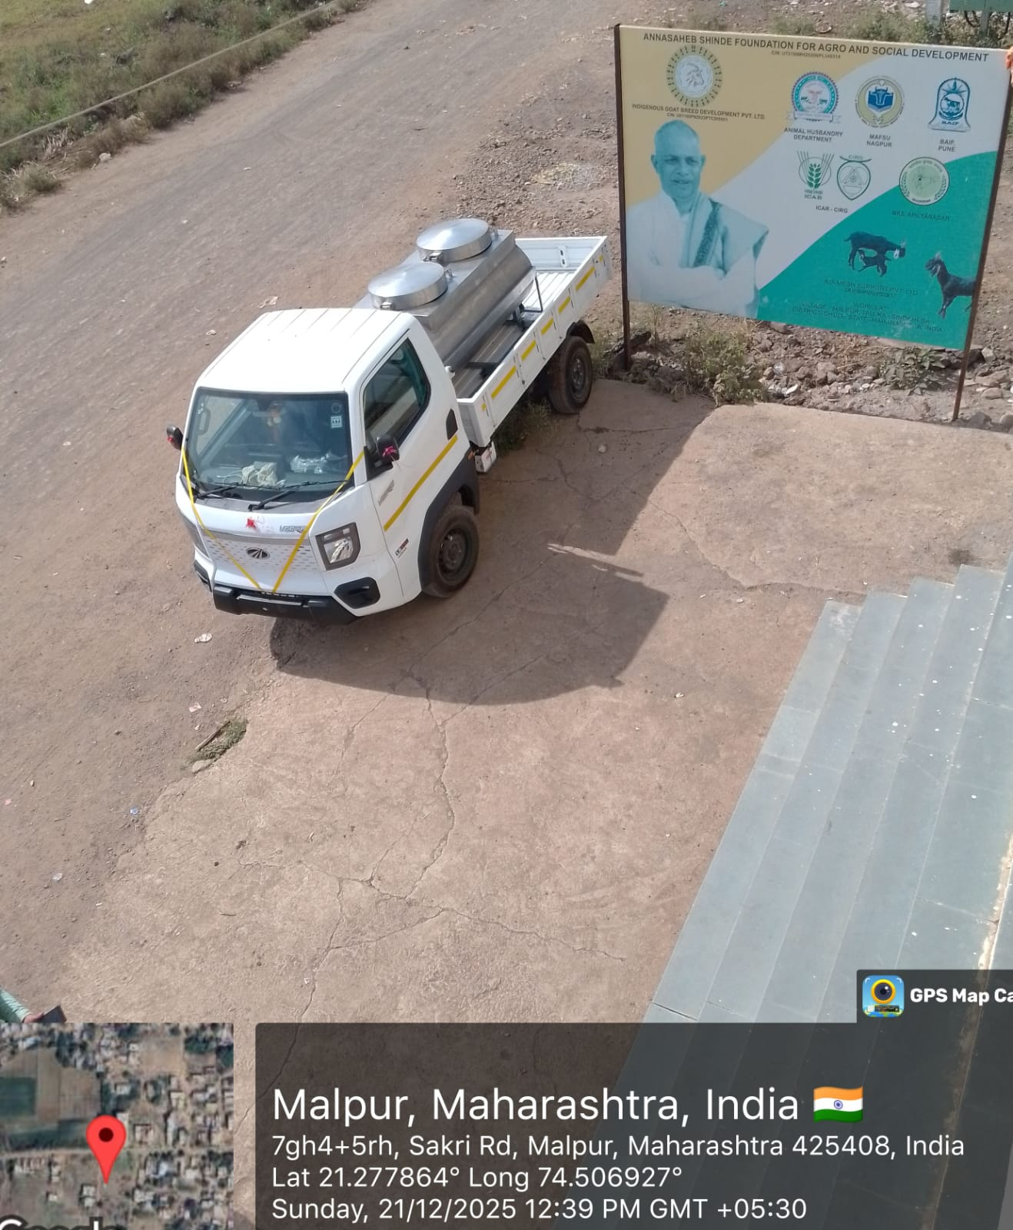
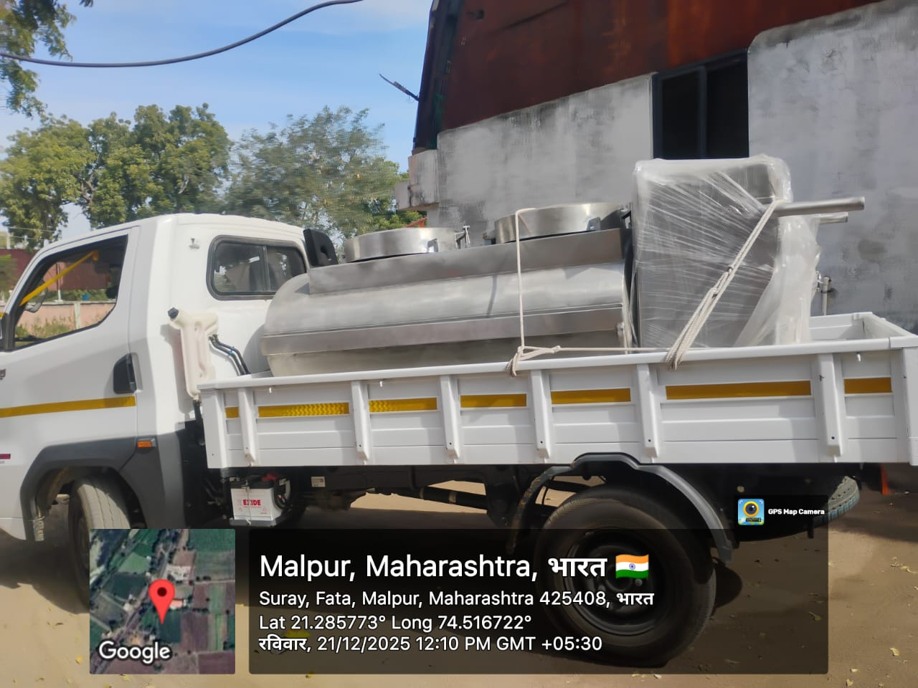
WE HAVE STARTED WORKING ON FOUR POINTS
GOAT MILK DAIRY
GOAT FEED UNIT
FERTILIZER FROM GOAT DUNG
PESTICIDES FROM GOAT URINE
Everyday DELIVERY of
ZALAWADI GOAT MILK
Started
FROM MALPUR.

Slide 15
PROJECT ADDRESS:
GOAT DAIRY, AMRAVATI DAM ROAD,
AT VILLAGE MALPUR, SINDKHEDA,
DIST: DHULE, MAHARASHTRA 425408
CONTACT:
MR. KIRAN SHREEKANT PATWARDHAN
CHIEF EXECUTIVE OFFICER, IGBDPL.
 77090 10407 / 94230 12256
 igbdpl22@gmail.com

